Slide 1
Exception Handling
Chapter 4 Part 1

Slide 2
Contents
Introduction
Exception Handling
Exception classes in C#
User defined Exception
Benefits of Exceptions

Slide 3
Introduction
There are three categories of errors:
Syntax errors arise because the rules of the language have not been followed. They are detected by the compiler.
Runtime errors occur while the program is running if the environment detects an operation that is impossible to carry out.
Logical errors occur when a program doesn't perform the way it was intended to.

Slide 4
Exception
An Exception
It is a problem that arises during the execution of a program.
A C# exception is a response to an exceptional situation that arises while a program is running, such as an attempt to divide by zero.
Exceptions provide a way to transfer control from one part of a program to another

Slide 5
Exception in .NET is an object, which signals an error or an event, which is not anticipated in the normal program flow.
When such unusual event takes place, the executing method ’throws' a special object containing information about the type of the error, the place in the program where the error occurred as well as the program state at the moment of the error.
Each exception in .NET contains the so-called stack trace, which gives information of where exactly the error occurred.

Slide 6
Exception Handling
Exception handling is a mechanism, which allows exceptions to be thrown and caught.
This mechanism is provided internally by the CLR (Common Language Runtime).
Parts of the exception handling infrastructure are the language constructs in C# for throwing and catching exceptions.
CLR takes care to propagate each exception to the code that can handle it.

Slide 7
How Do Exceptions Handling Work?
The exception handling mechanism follows a reversed process.
When an exception is thrown, CLR begins searching an exception handler in the callstack starting from the method that has thrown the exception.
This is repeated for each of the methods down the call-stack until a handler is found which catches the exception.
If Main(…) is reached and no handler is found, CLR catches the exception and usually displays an error message (either in the console or in a special error dialog box).

Slide 8
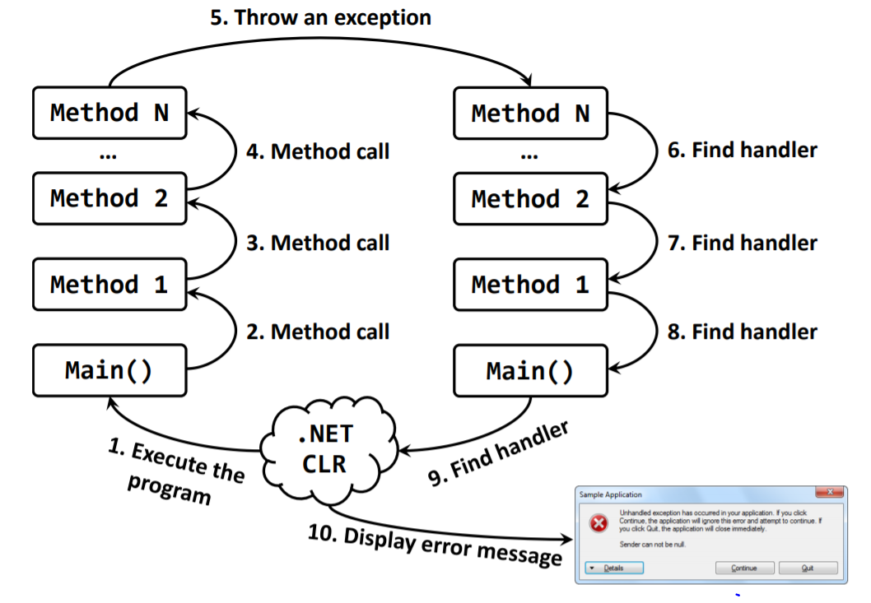

Slide 9
C# exception handling is built upon four keywords:
try: A try block identifies a block of code for which particular exceptions will be activated.
It's followed by one or more catch blocks.
catch: A program catches an exception with an exception handler at the place in a program where you want to handle the problem.
The catch keyword indicates the catching of an exception.

Slide 10
finally: The finally block is used to execute a given set of statements, whether an exception is thrown or not thrown.
For example, if you open a file, it must be closed whether an exception is raised or not.
throw: A program throws an exception when a problem shows up. This is done using a throw keyword.

Slide 11
try block
A try block contains code that requires common cleanup or exception-recovery operations.
The cleanup code should be put in a single finally block.
The exception recovery code should be put in one or more catch blocks.
Create one catch block for each kind of type you want to handle.
A try block must have at least one catch or finally block.

Slide 12
Cont.
catch block
A catch block contains code to execute in response to an exception.
If the code in a try block doesn’t cause an exception to be thrown, the CLR will never execute the code in any of its catch blocks.
You may or may not specify a catch type in parenthesis after catch :
The catch type must be of type System.Exception or a type that derived from System.Exception
If there is no catch type specified, that catch block handles any exception. This is equivalent to having a catch block that specifies System.Exception as a catch type.

Slide 13
Once the catch block that matches the exception is found, you have 3 choices:
Re-throw the same exception, notifying the higher-up call stack of the exception
Throw a different exception, giving richer exception information to code higher-up in the call stack
Let the code continue from the bottom of the catch block
In choices 1-2, an exception is thrown and code starts looking for a catch block whose type matches the exception thrown
In choice 3, the finally block is executed
You can also specify a variable name like catch(Exception e) to access information specific to the exception.

Slide 14
finally block
C# provides the finally block, which is guaranteed to execute regardless of whether an exception occurs.
If the try block executes without throwing, the finally block executes.
If the try block throws an exception, the finally block still executes regardless of whether the exception is caught.
This makes the finally block ideal to release resources from the corresponding try block.

Slide 15
Local variables in a try block cannot be accessed in the corresponding finally block, so variables that must be accessed in both should be declared before the try block.
Placing the finally block before a catch block is a syntax error.
A try block does not require a finally block, sometimes no clean-up is needed.
A try block can have no more than one finally block.

Slide 16
Syntax
Assuming a block will raise and exception, a method catches an exception using a combination of the try and catch keywords.
You can list down multiple catch statements to catch different type of exceptions in case your try block raises more than one exception in different situations.

Slide 17
try {
// code that requires common cleanup or
// exception-recovery operations
}
catch (InvalidOperationException) {
//code that recovers from an InvalidOperationException
// (or any exception type derived from it)
}
catch (SomeOtherException) {
// code that recovers from an SomeOtherException
// (or any exception type derived from it)
}
catch {
// code that recovers from any kind of exception
// when you catch any exception, you usually re-throw
throw;
}
finally {
// code that cleans up any operations started
// within the try block. This code ALWAYS executes.
}

Slide 18
Exception Classes in C#
C# exceptions are represented by classes.
The exception classes in C# are mainly directly or indirectly derived from the System.Exception class.
Some of the exception classes derived from the System.
Exception class are the System.ApplicationException and System.SystemException classes.

Slide 19
The System.ApplicationException class supports exceptions generated by application programs.
So the exceptions defined by the programmers should derive from this class.
The System.SystemException class is the base class for all predefined system exception.

Slide 20
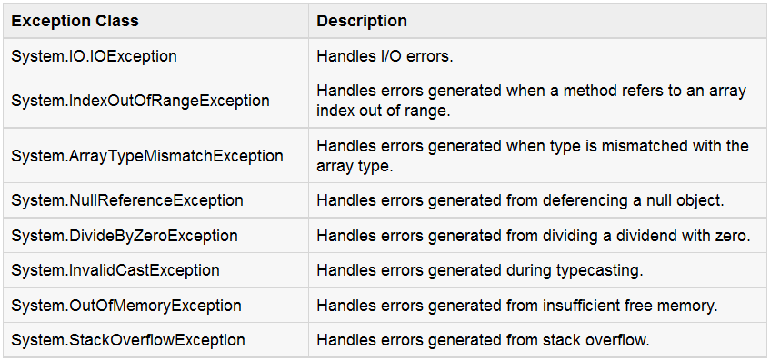
There are another Exception classes in C#, search about them !!

Slide 21
System.Exception properties
Class Exception’s properties are used to formulate error messages indicating a caught exception.
Property Message stores the error message associated with an Exception object.
Property StackTrace contains a string that represents the method-call stack.
When an exception occurs, a programmer might use a different error message or indicate a new exception type.
The original exception object is stored in the InnerException property.

Slide 22
Other properties:
HelpLink specifies the location of a help file that describes the problem.
Source specifies the name of the application or object that caused the exception.
TargetSite specifies the method where the exception originated.

Slide 23
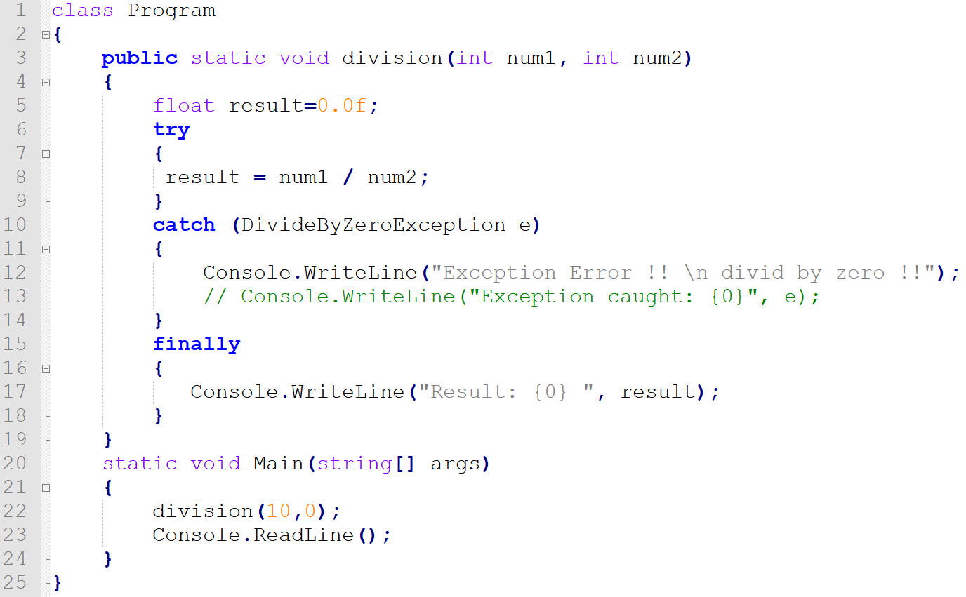
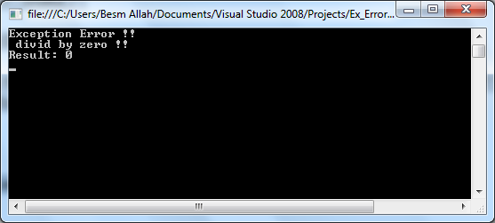
Example 1:

Slide 24
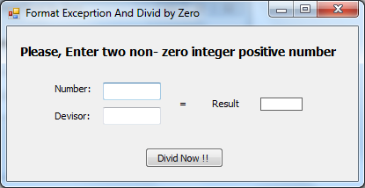
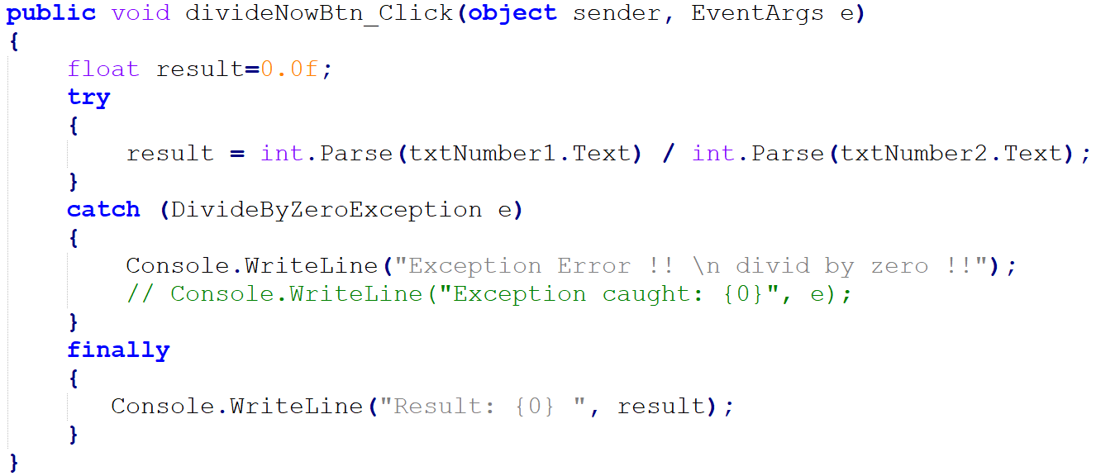
Example 2:

Slide 25
Choosing the Exception to throw
When implementing your own methods, you should throw an exception when the method cannot complete its task.
Associating each type of malfunction with an appropriately named exception class improves program clarity.
What Exception-derived type are you going to throw?
What string message are you going to pass to the exception type’s constructor?

Slide 26
Do not catch everything?
try {
// code that might fail…
}
catch (Exception) {
…
}
How can you write code that can recover from all situations???
A class library should never ever swallow all exceptions. The application should get a chance to handle the exception.
You can catch all exceptions only if you are going to process it and re-throw it again.

Slide 27
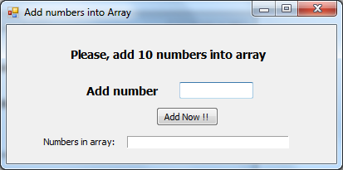
Exercise 1:
Use
IndexOutOfRangeException
&
FormatException
&
Exception

Slide 28
User Defined Exceptions
User-defined exception classes should derive directly or indirectly from class Exception of namespace System.
Exceptions should be documented so that other developers will know how to handle them.
User-defined exceptions should define three constructors:
A parameterless constructor
A constructor that receives a string argument (the error message)
A constructor that receives a string argument and an Exception argument (the error message and the inner exception object)

Slide 29
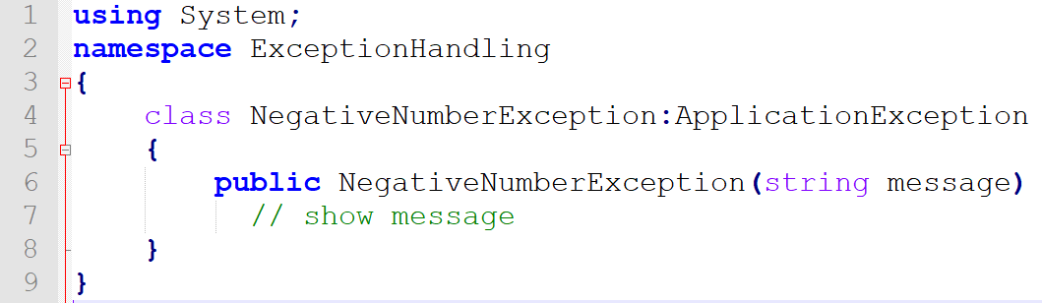
Example 2:
if(value<0)
throw new NegativeNumberException(" Use Only Positive numbers");

Slide 30
Benefits of Exceptions
The ability to keep cleanup code in a dedicated location and making sure this cleanup code will execute
The ability to keep code that deals with exceptional situations in a central place
The ability to locate and fix bugs in the code
Unified error handling: all .NET Framework classes throw exceptions to handle error cases

Slide 31
Exceptions also include a stack trace that tells you the path application took until the error occurred.
You can also put any information you want in a user-defined exception of your own.
The caller could ignore the error returned by a Win32 API, now the caller cannot continue with exceptions. If the application cannot handle the exception, CLR can terminate the application.

Slide 32
Exercise 2:
An exception is a problem that arises?
Before the execution of a program
During the execution of a program
After the execution of a program
None of the above
C# exception handling is built upon __________ keywords.
One
Two
Three
Four

Slide 33
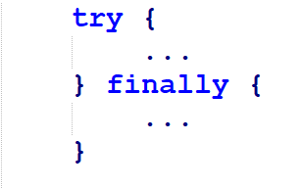
Exercise 3:
Is the following code legal?

Slide 34
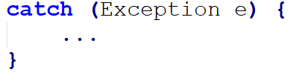
Exercise 4:
What exception types can be caught by the following handler?
What is wrong with using this type of exception handler?

Slide 35
Exercise 5: Order of Exception
(A)
(B)
void function1() {
try
{
// code
}
catch(Exception ex)
{
}
catch(Exception1 ex)
{ }
}
void function1() {
try
{
// code
}
catch(Exception1 ex)
{
}
catch(Exception ex)
{ }
// if no rethrow occurs
// execution resumes here
}

Slide 36
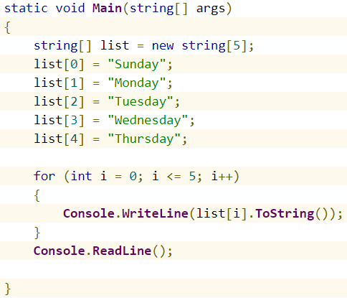
Exercise 6: Adding Exceptions-1
This program is throwing exception IndexOutOfRangeException.

Slide 37
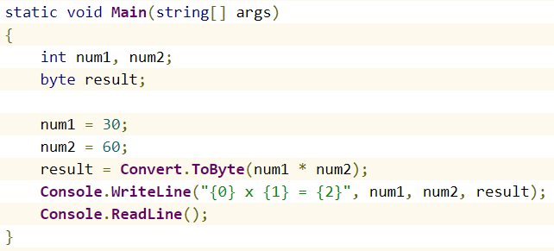
Exercise 7: Adding Exceptions-2
The given program is throwing OverflowException

Slide 38
Exercise 8: FormatExceptions
Create a program that inputs miles driven and gallons used, and calculates miles per gallon.
The example should use exception handling to process the FormatExceptions that occur when converting the input strings to doubles. If invalid data is entered, display a message informing the user

Slide 39
Exercise 9:
Write a C# program that prompts the user to input two numbers and divides them. Handle an exception when the user enters non-numeric values.
Write a C# program that prompts the user to input a numeric integer and throws an exception if the number is less than 0 or greater than 1000.
Write a C# program that implements a method that takes an array of integers as input and calculates the average value. Handle the exception if the array is empty.
Write a C# program that reads a string from the user and converts it to an integer. Handle the exception if the input cannot be parsed into an integer.
Write a C# program that reads a list of integers from the user. Handle the exception that occurs if the user enters a value outside the range of Int16.
9. Write a C# program that creates a method that reads a date from the user in the format "dd/mm/yyyy" and converts it to a DateTime object. Handle an exception if the input format is invalid.

Slide 40
Exercise 10: User defined Exception-1
Write a program that takes a positive integer from the textboxand prints the square root of this integer. If the input is negative or invalid print "Invalid Number" in the console. In all cases print "Good Bye".

Slide 41
Exercise 10: User defined Exception-2
Write a method ReadNumber(int start, int end) that reads an integer from the textbox in the range [start…end].
In case the input integer is not valid or it is not in the required range throw appropriate exception.
Using this method, write a program that takes 10 integers a1, a2, …, a10 such that 1 < a1 < … < a10 < 100.
(When invalid number is used we can throw Exception because there is no other exception that can better describe the problem. As an alternative we can define our own exception class called in a way that better describes the problem, e.g. InvalidNumberException)

Slide 42
Questions?

Slide 43
Thank You

